Slide 1
Cannondale
Data Science Consulting

Slide 2
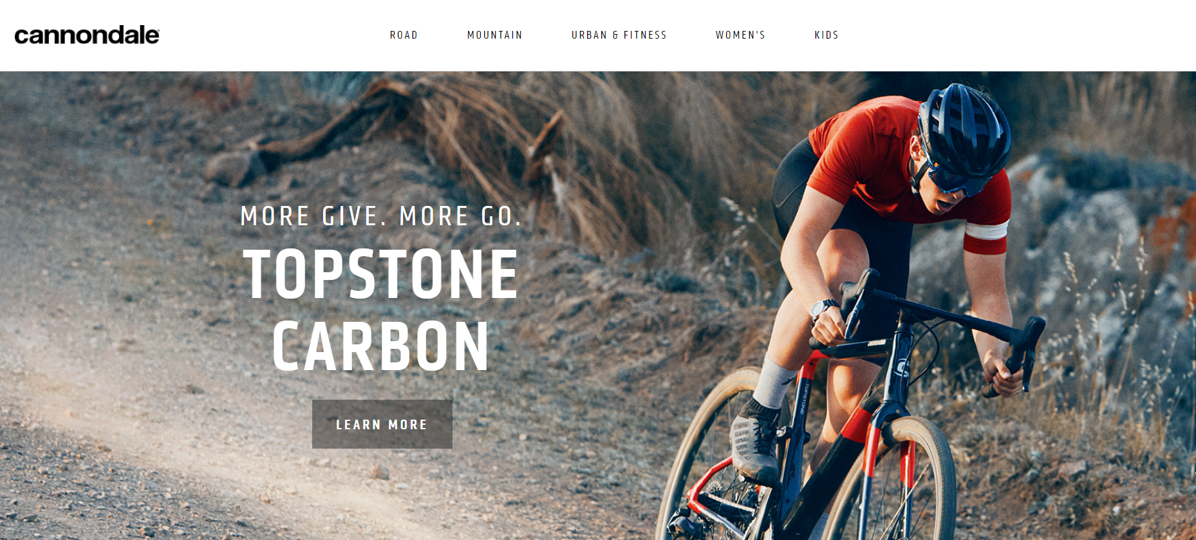
Cannondale
Notes:
The Cannondale Bicycle Corporation is an American division of Canadian conglomerate Dorel Industries that supplies bicycles. It is headquartered in Wilton, Connecticut with manufacturing and assembly facilities in China

Slide 3
Data Science Consulting Project
Applying cutting-edge predictive analysis and machine learning
Providing in-depth analysis on the following:
Sales Trends
Product Recommendation
Customer Segmentation

Slide 4
Data Science Process
Cleaning the data
Building models to derive insights
Presenting insights
Gathering data
Understanding the Business

Slide 5
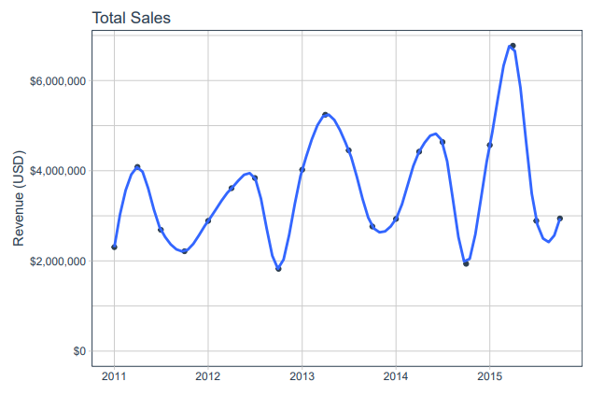
Quarterly Sales Trends

Slide 6
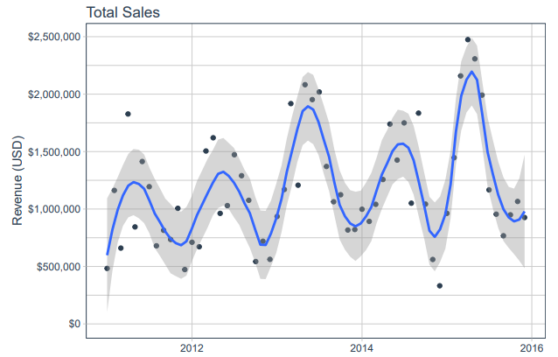
Monthly Sales Trends

Slide 7
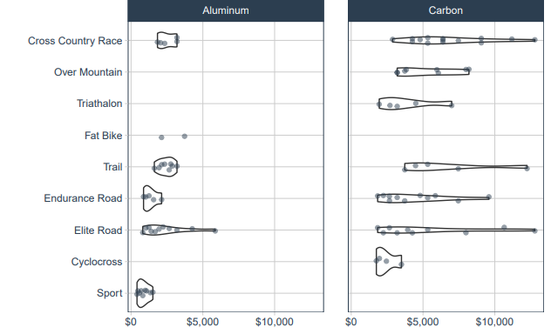
Product Gap Analysis
Notes:
Gap in the Aluminum Over Mountain and Triathalon categories

Slide 8
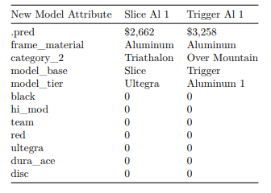
Price Predictions

Slide 9
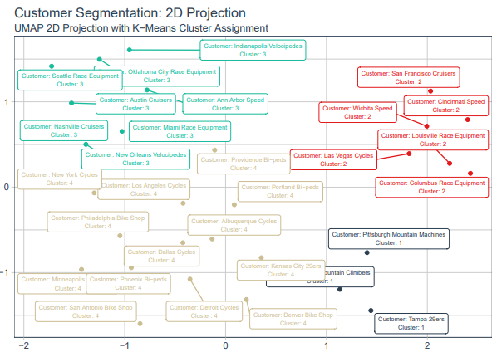
Customer Segmentation
Notes:
Segment 1 Preferences: Mountain Bikes, Above $3200 (Premium Models)
Segment 2 Preferences: Road Bikes, Above $3200 (Premium Models)
Segment 3 Preferences: Road Bikes, Below $3200 (Economical Models)
Segment 4 Preferences: Both Road and Mountain Bikes, Below $3200 (Economical Models)

Slide 10
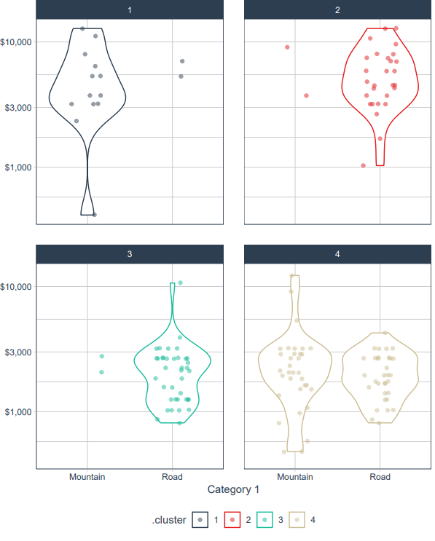
Top 5 Bike Models by Customer and Cluster

Slide 11
Further Information
For all of the source code and pdf/html files, please visit: https://github.com/JosephcsKong/Cannondale_Data_Science_Consulting

Slide 12
Q&A

